Slide 1

Analysis and Prediction on Cryptocurrencies
Eric Droegemeier
Gregory Ehlinger
Tejaskumar Patel
Brad Reese

Slide 2
Objectives
Understanding how cryptocurrency is having an impact on the world today
Evaluating cryptocurrency as an investment
Evaluating cryptocurrency as a hedge to inflation
Predicting the price of Bitcoin
Notes:
Our objective is to understand how cryptocurrency is having an impact on the world today. We want to evaluate cryptocurrency as an investment. Also, we will look at if cryptocurrency is a good hedge against inflation. We demonstrate a regression analysis on predicting the price of Bitcoin.
who is our target audience: savvy and curious investors who are looking to diversify into new or unconventional sources
TEJAS

Slide 3
Hypothesis
Null Hypothesis: Cryptocurrency are not correlated to traditional investment options such as stocks, gold, silver, and other commodities.
Alternative Hypothesis: Cryptocurrency are correlated to traditional investment options and will be a sound investment option as a way of diversifying a portfolio that contains stocks, metals, or other coins.

Slide 4
Target Audience
People interested in knowing more about cryptocurrency
Risk willing investors
Previous Investors in cryptocurrencies
Investors looking to hedge against inflation
Notes:
TEJAS

Slide 5
Data Collection
Daily Data for 5 years (1/1/2017 – 9/1/2022)
Annual Data (2002 – 2021)
Metals
Silver
Gold
Indices
S&P 500
Russell 3000
FX Currency Exchanges
EURUSD=X
Commodities
Crude
Wheat
Cryptocurrencies
ETH
BTC
SOL
AVAX
ADA
DOT
DOGE
SHIB
UNISWAP
Economic Indicators
Unemployment
GDP
M2 Money Supply
10-year yield
Investments/Assets
Silver
Crude
Russell 3000
Source Citation:
URL: https://finance.yahoo.com/portfolios
Website: Yahoo! Finance Date Accessed: December 4, 2022
Source Citation:
URL: https://www.dol.gov/general/topic/statistics/employment
Website: United States Department of Labor Date Accessed: December 4, 2022
Source Citation:
URL: https://tradingeconomics.com/united-states/money-supply-m2
Website: United States Money Supply M2 - November 2022 Data - 1959-2021 Historical
Date Accessed: December 4, 2022
Notes:
We pulled daily data for the last five years where it was available. We included gold and silver as our metals. S&P 500 and Russell 3000 are the stock indices that we used. Our FX exchange is based on Euro/USD. The commodities we picked for our analysis are crude and wheat. We pulled 9 cryptocurrencies, for up to 5 years if the data was available. Ethereum, Bitcoin, and Doge have five years of data. The other cryptocurrencies do not have 5 years of data, and we omit where the data is missing. Our risk-free rate is the 10-year yield. We also included an annualized dataset for 2002-2021. This included economic indicators such as unemployment, GDP and M2 Money Supply.
TEJAS

Slide 6
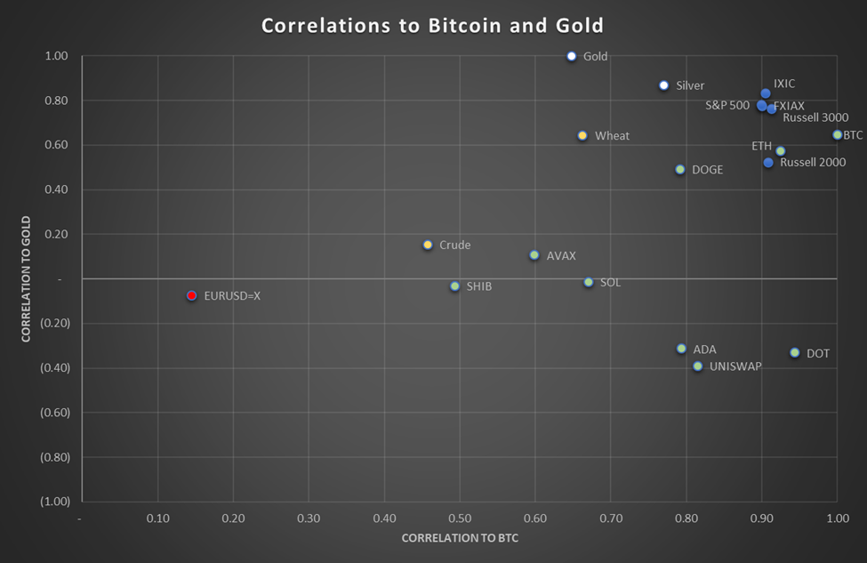
Defining Cryptocurrency
Bitcoin correlates closely with stock indices
Russell 3000
S&P 500
Nasdaq (IXIC)
Mature cryptocurrencies also correlate well to stock indices
Bitcoin also has a moderately strong correlation to metals such as Gold and Silver
Newer cryptocurrencies have a neutral to negative correlation to Gold
Ethereum killers have a moderate correlation to Bitcoin
No correlation to FX exchange
Notes:
When we do an analysis on correlations to Bitcoin and Gold, we can see some interesting conclusions.
First, we note that Bitcoin correlates closely with stock indices.
Second, we can see that the mature cryptos also have strong correlations to stock indices. These include Doge and Ethereum, both have been in circulation for over 5 years.
Next we see that newer cryptocurrencies have low to negative correlation to Gold.
ERIC

Slide 7
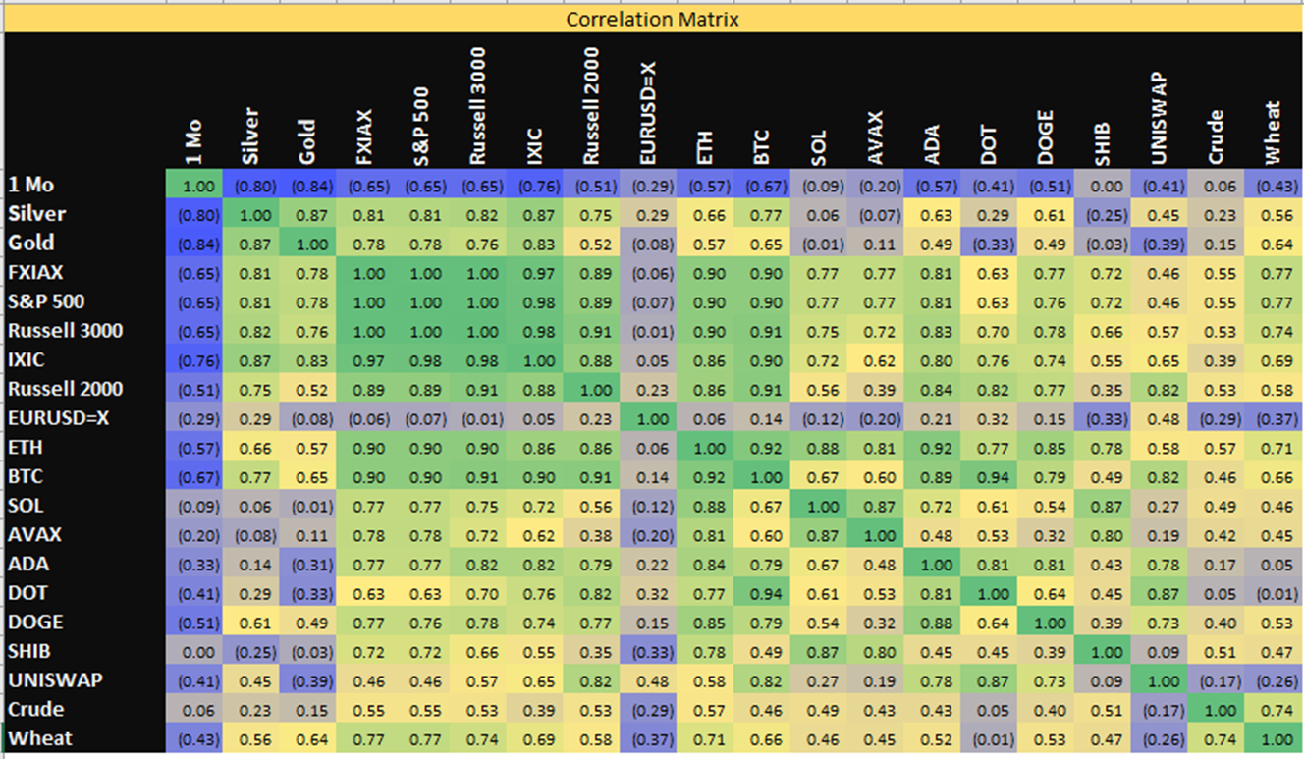
Correlations
Notes:
ERIC

Slide 8
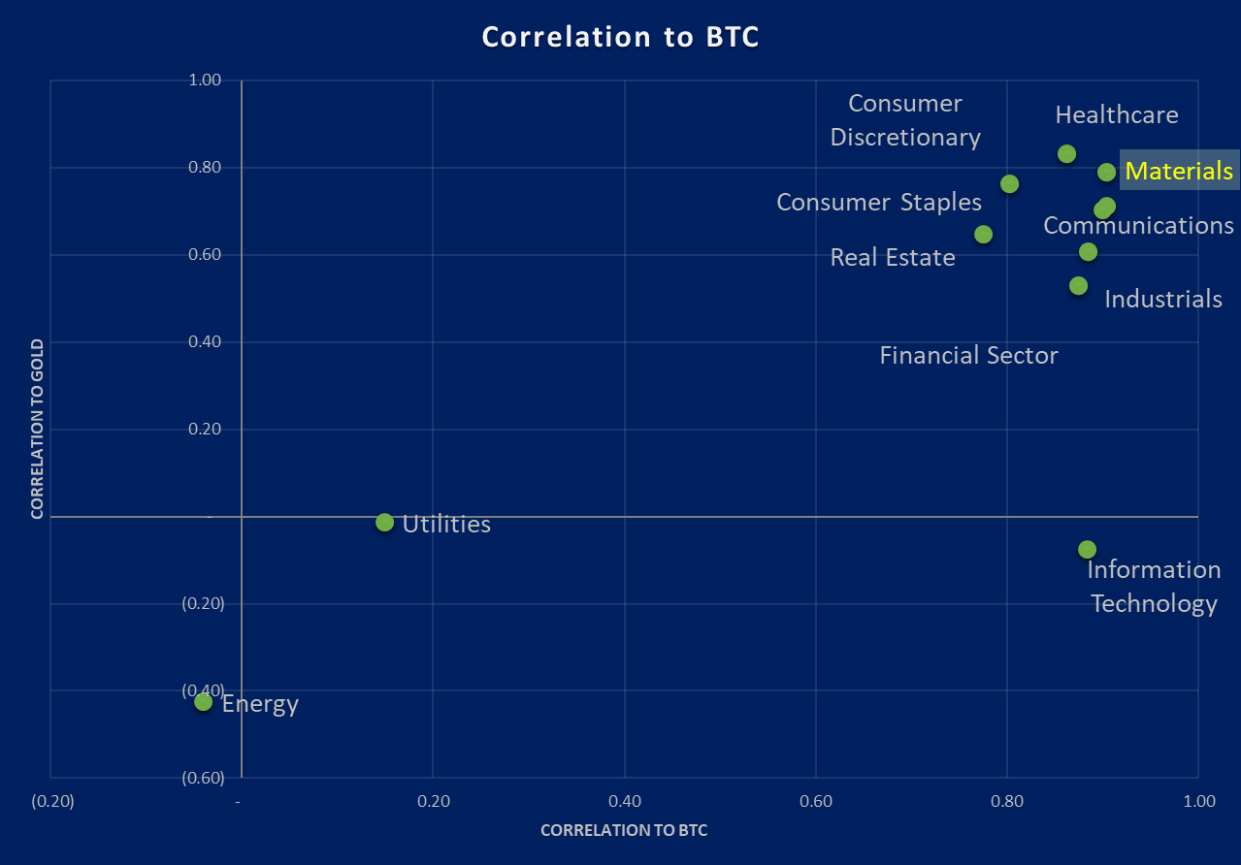
Industrial Sector Comparisons
Which Market Sector does Cryptocurrency Correlate to Most Strongly
We are using Bitcoin as a proxy for cryptocurrency
Bitcoin most closely correlates to the materials industry sector
Knowing this correlation, we can look at the materials sector for when to buy and sell
Notes:
One theory is that cryptocurrency will become the 12th next industrial sector.
We use Bitcoin as the proxy for cryptocurrencies as a whole.
You can see that several industrial sectors have a high correlation to Bitcoin.
We can select materials as the most appropriate sector.
In this scenario we would invest and divest at the same time as the materials sector.
The best time to invest in materials is when the fed tightens rates up to 4%
The best time to sell is when one of the following events happen:
The Federal Reserve increases rates above 5%
The Federal Reserve stays neutral on rates for several meetings with the rates being above 4% but below 5%
The Federal Reserve decreases rates by 1% from its peak. (This can be over multiple sessions)
We are at 3.75% to 4.00% target fed funds rate
A good hedge if investing in cryptocurrency is investing in Energy or Industrials
GREGORY
As we observed from our correlation chart, mature cryptocurrencies have a very strong positive correlation with stock indexes. So we wanted to conduct further analysis on this relationship. Index funds can be broken up into 11 industrial sectors. We conducted another correlation analysis to see which sector is most correlated to Bitcoin, the proxy for cryptocurrencies. And from this analysis, we determined that the materials sector and bitcoin have the highest positive correlation. So what can we do with this information? We can bitcoin’s relationship to the material sector to determine when would be the most opportune time to buy bitcoin.

Slide 9
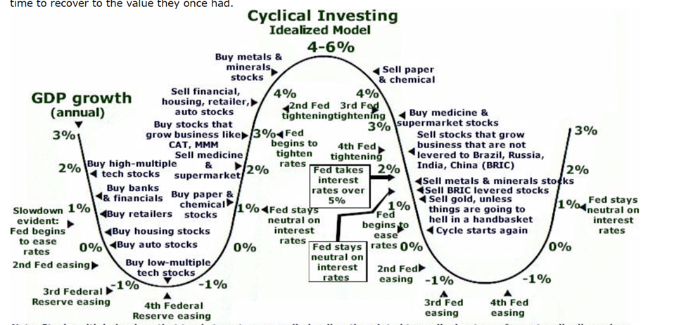
Industrial Sector Comparisons
Which Market Sector does Cryptocurrency Correlate to Most Strongly
1
2
1
Buy
Currently we are at this point
Fed tightening to 3.75%
Fed outlook slowing, with rate decreases being discussed
2
Hold
Projected apex of rate increases, May 2023
Assuming inflation is more manageable
GDP and Unemployment numbers will influence this
3
3
Sell
Scenario A: Inflation continues and Fed takes rates over 5%
Scenario B: Fed eases rates due to economic downturn or inflation subsiding
Source Citation:
URL: http://sectormarketwatch.com/cyclicals.htm
Website: Sector Rotation cyclicals
Date Accessed: December 4, 2022
Notes:
One theory is that cryptocurrency will become the 12th next industrial sector.
We use Bitcoin as the proxy for cryptocurrencies as a whole.
You can see that several industrial sectors have a high correlation to Bitcoin.
We can select materials as the most appropriate sector.
In this scenario we would invest and divest at the same time as the materials sector.
The best time to invest in materials is when the fed tightens rates up to 4%
The best time to sell is when one of the following events happen:
The Federal Reserve increases rates above 5%
The Federal Reserve stays neutral on rates for several meetings with the rates being above 4% but below 5%
The Federal Reserve decreases rates by 1% from its peak. (This can be over multiple sessions)
We are at 3.75% to 4.00% target fed funds rate
A good hedge if investing in cryptocurrency is investing in Energy or Industrials
GREGORY
As we observed from our correlation chart, mature cryptocurrencies have a very strong positive correlation with stock indexes. So we wanted to conduct further analysis on this relationship. Index funds can be broken up into 11 industrial sectors. We conducted another correlation analysis to see which sector is most correlated to Bitcoin, the proxy for cryptocurrencies. And from this analysis, we determined that the materials sector and bitcoin have the highest positive correlation. So what can we do with this information? We can bitcoin’s relationship to the material sector to determine when would be the most opportune time to buy bitcoin.

Slide 10
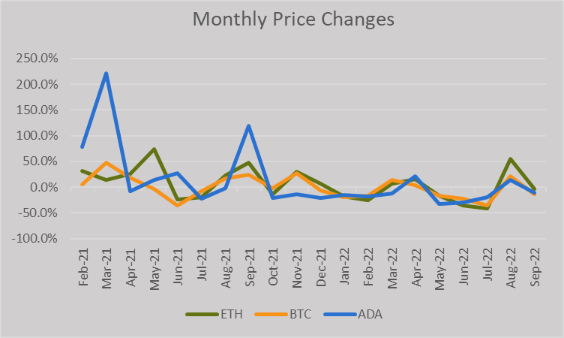
Recent Trends
This chart shows the price changes of crypto over the past year and a half. After it’s peak in early 2021, crypto has hovered around zero in price change since October ‘21
Notes:
GREGORY

Slide 11
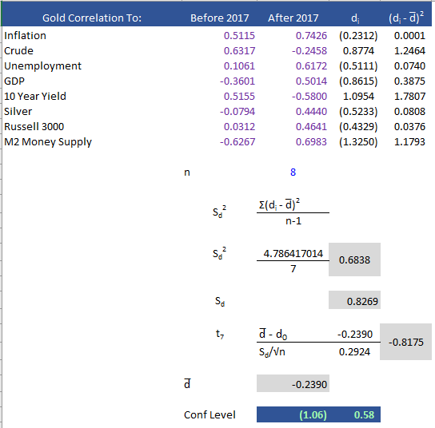
The New Gold Standard?
Gold’s Correlations before and after the arrival of Cryptocurrency
Hypothesis: Gold has lost its relevance, and that is has been replaced by Cryptocurrency as a store of value.
Summary of Calculations
Comparison Periods Before and After Cryptocurrency became relevant
Selected economic indicators that have a strong influence on the price of Gold
Included Silver as a comparison a companion comparison point
Specifically included inflation and M2 Money Supply as cryptocurrency is designed to be deflationary
History of inflation
Rome’s inflation was 15,000% between AD 200 and 300
Zimbabwe Dollar
Continental Currency 1779
Notes:
Has Bitcoin replaced gold as a store of value in uncertain economic times?
We looked at the correlations of gold to different macro economic indicators before and after the ‘arrival’ of Bitcoin.
For the before analysis, we used the period of 2002 – 2016.
For the after period, we used 2017-2022.
2017 is the year when Bitcoin broke the $10k mark.
Based on our analysis, we cannot conclude that gold has lost is value.
Cryptocurrency is designed to be deflationary.
BRAD

Slide 12
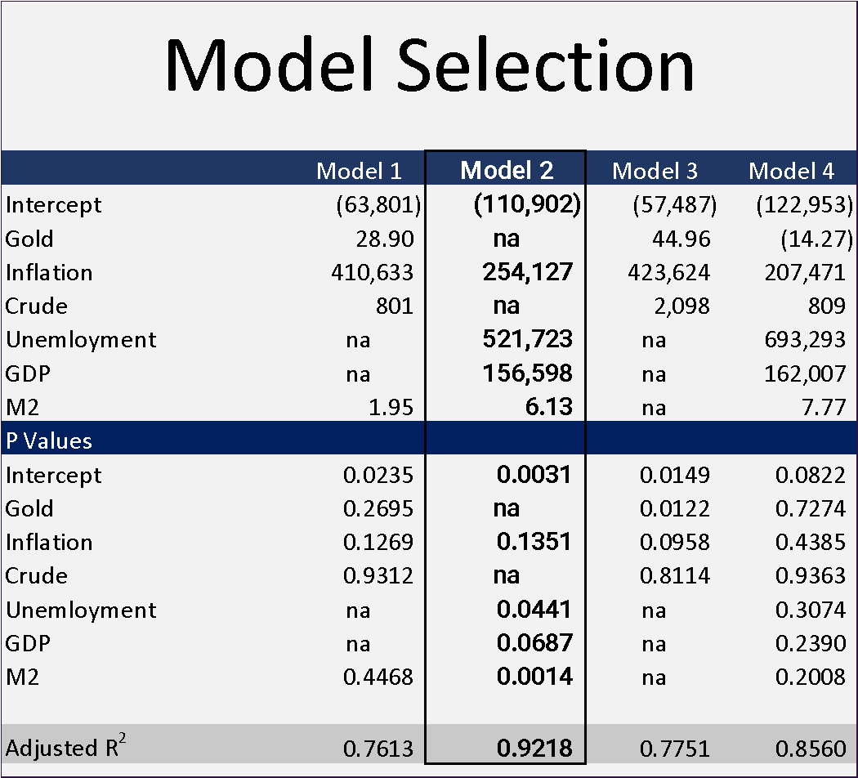
Regression Analysis
Regression Testing to Predict Price of Bitcoin
Selected variables that are macro economic related, and not stock related
Model 2 had the best predictive results
Model 2 contained economic variables, and excluded investment options (Gold and Crude)
P-values were reasonable, but several were higher than we would like.
Intercept is negative
Notes:
We ran several regression models to predict the value of bitcoin.
Included in the models were Macro Economic Variables including Inflation, Unemployment, GDP and M2 Money Supply.
Also considered were two assets, Gold and Crude.
Several observations about the model
The intercept is negative
P-Values for Gold and Crude are high
The highest Adjusted R-Squared is model 2
Model two has low P-Values for Unemployment and M2.
GDP has a P-Value of about 7%, but we still consider it
Inflation’s P-Value is .135, and we are considering it also
BRAD

Slide 13
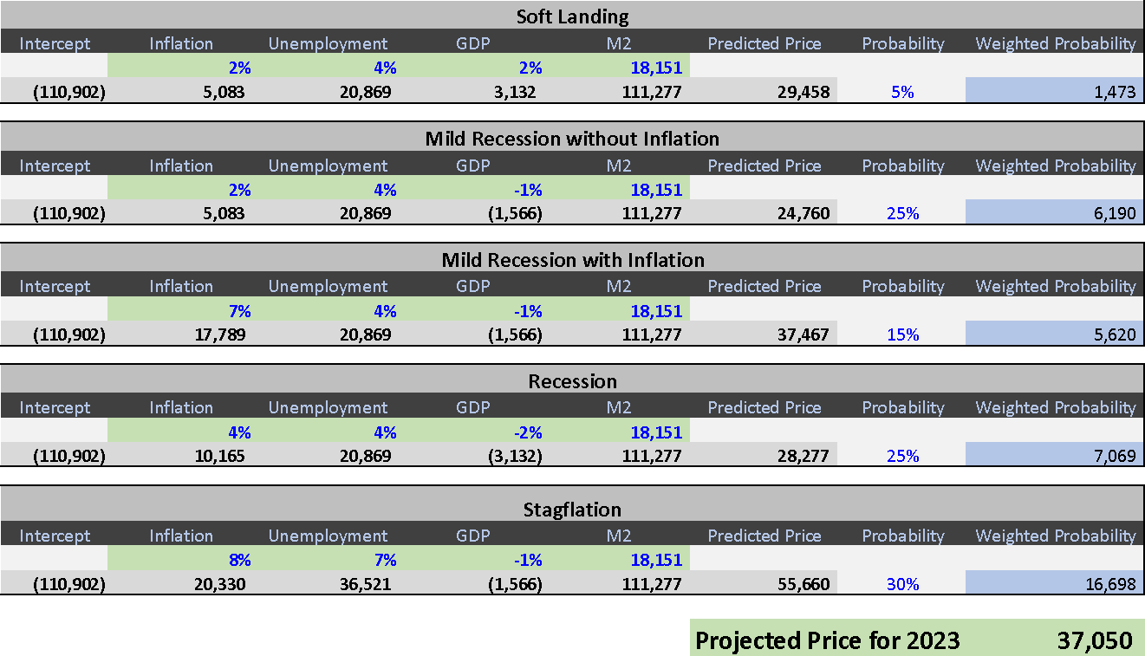
2023 Bitcoin Price Outlook
Notes:
We run several models based on different economic scenarios to project the price of Bitcoin.
Ranging from a Soft Landing to Stagflation.
We weighted each scenario based on the subjective probability.
For a soft landing, we are estimating inflation coming down to 2%, unemployment remaining at 4% and a GDP growth of 2%. M2 Money Supply will remain constant.
This gives us an estimated price of $29,458
For a Soft Landing:
We are estimating inflation coming down to 2%
Unemployment remaining at 4%
GDP growth of 2%
M2 Money Supply will remain constant.
This gives us an estimated price of $29,458
For a Mild Recession without Inflation:
We are estimating inflation coming down to 2%
Unemployment remaining at 4%
GDP growth of -1%
M2 Money Supply will remain constant.
This gives us an estimated price of $24,760
For a Mild Recession with Inflation:
We are estimating inflation coming down to 7%
Unemployment remaining at 4%
GDP growth of -1%
M2 Money Supply will remain constant.
This gives us an estimated price of $27,467
For a Recession:
We are estimating inflation to be 4%
Unemployment remaining at 4%
GDP growth of -2%
M2 Money Supply will remain constant.
This gives us an estimated price of $28,277
For Stagflation:
We are estimating inflation to be 8%
Unemployment remaining at 7%
GDP growth of -1%
M2 Money Supply will remain constant.
This gives us an estimated price of $55,660
BRAD

Slide 14
Conclusion and Suggestions for Audience
Cryptocurrency will be a sound investment option as a way of diversifying a portfolio that contains stocks, metals, or other coins.
From an investing perspective, limit your exposure
For cyclical investing, look at trends in the materials industry sector
Like Gold, cryptocurrencies have become a viable asset to protect against inflation
Look for additional educational resources on the Cryptocurrency Market
Notes:
From an investing perspective, limit your exposure: still risk like any investment, no guarantee, promising as it’s still new from technology adoption, however the next biggest hurdle is governments may regulate
for cyclical investing: you can hedge against risk with utilities and energy stock
The price of Bitcoin in particular is sensitive to macroeconomic variations
ERIC & ANYONE

Slide 15
THANKS
Do you have any questions?

